Slide 1
A Celebration of Life
For
Robert Michael Kelaghan
Born July 30th 1948 Providence, RI
Died January 13, 2026 Sacramento, CA
An Amazing, Soul-Filled Life, Very Well Lived

Slide 2
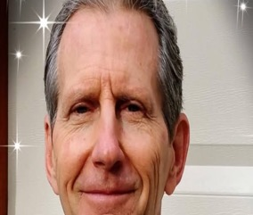
“It Takes A Village to Raise
A (Divine) Child”
Love, Gratitude and Grace Abounded Around Robert’s Journey

Slide 3
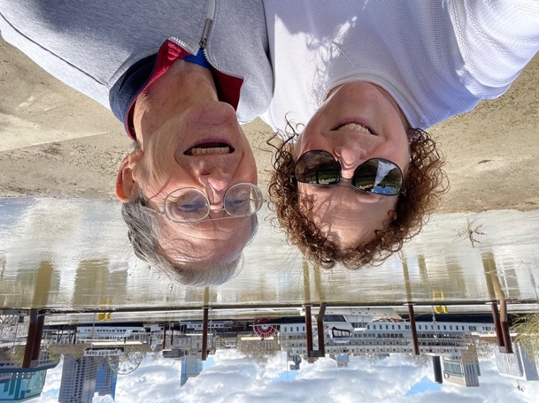
Special Thanks To Patricia London

Slide 4
Major Kudos and Deep Appreciation to Punita Greenberg and Chitra Diamond for their Seva
Without your tireless and loving support Robert would have ended up unhoused and forgotten.
Punita besides handling the details of this celebration of life, kept the information flow open to Robert’s friends, community and family by frequent posts on his email and Facebook accounts. She helped Robert get affordable assisted living and memory care: a miracle!
Chitra is a good, decades-long friend and former memory care nurse, t housed, feed and tended to Robert’s early medical and residential needs and kept the prayers going for him
It takes a village and committed community to “walk our friends back home” to Spirit

Slide 5
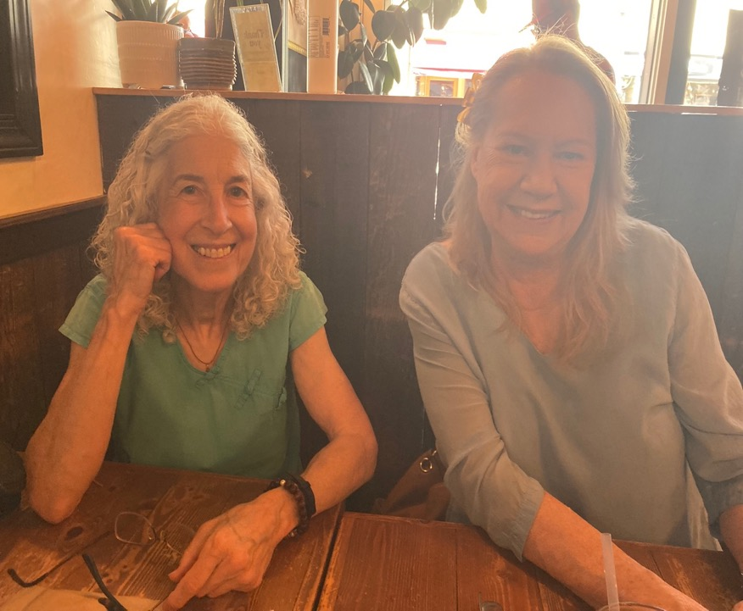

Slide 6
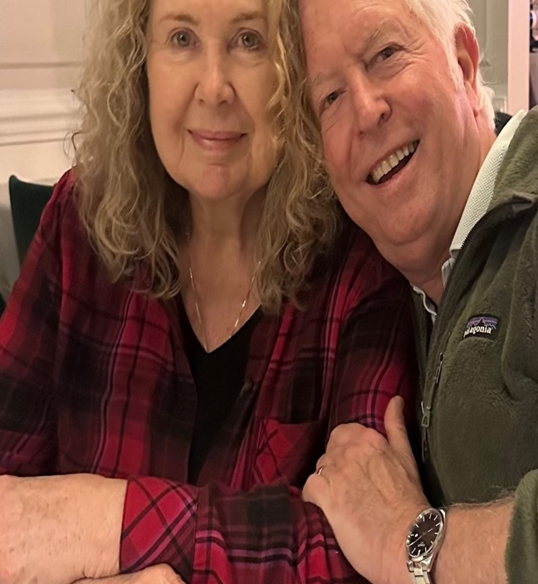
Much Love and Gratitude to my loving wife Jennifer whose compassion and constant support allowed me to be MIA as I spent a lot of time caring for Robert’s needs the last seven plus years
se

Slide 7
Robert lived and died as a devoted disciple of Parmahansa Yogananda
Robert exemplified Kriyananda’s aphorism: “Even in times of adversity a yogi is even-minded and cheerful”

Slide 8
Robert’s final wishes were to have a party with great food, where he could gift his friends with his CDs, enjoy music, share stories and loving connections
The three CDS (actually 5 CDs on the gift table) include:
“A Tribute To Yogananda”
“In the Presence of the Most High”
”The Crazy Karma Kirtan Band: Bootleg Album.”
”The Beauty That Lies Within You.”
“Bringers of The Light.”
“Vision Becomes Reality

Slide 10
Many Thanks For Today’s Lunch Go To
Chef Kelly Tejada of Moonshine Organics
Kelly specializes in plant-based vegetarian world cuisine. She caters and offers meal prep services and is trained to provide individualized Ayurvedic healing diets. She’s also the tech genius who helped with our Evites and SpotFund

Slide 11
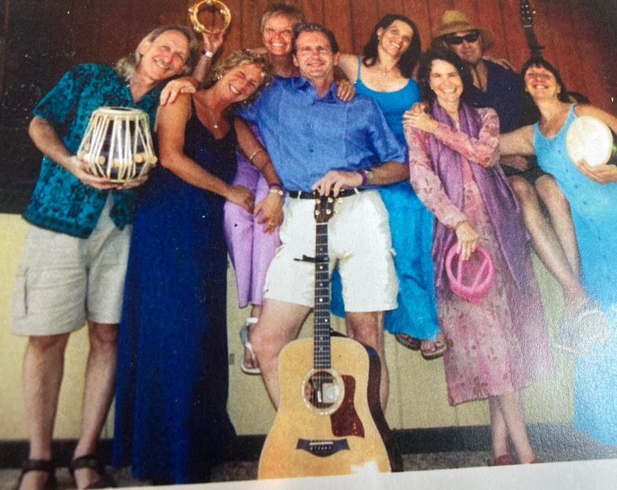
The Crazy Karma Kirtan Band
“The live CKKB Bootleg CD”
Is another of his Giveaway CDs

Slide 12
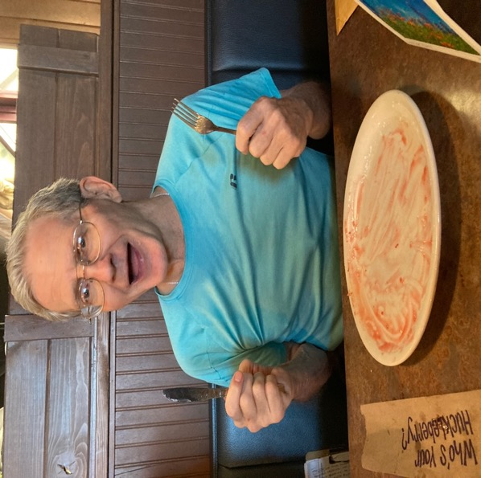
Robert loved
Sharing Food With Friends!

Slide 13
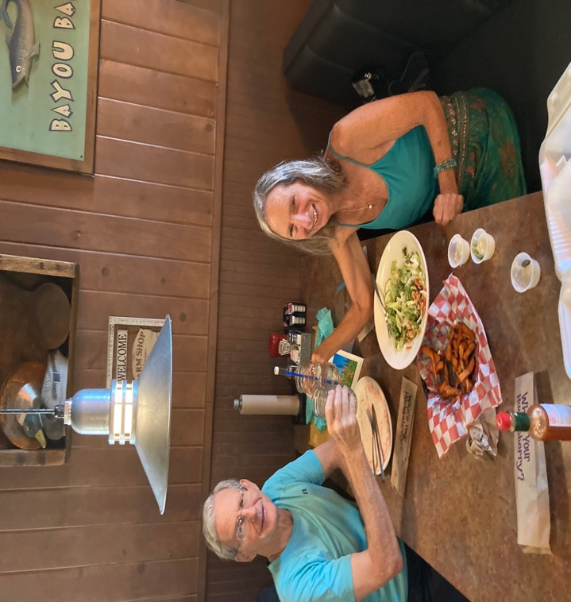

Slide 14
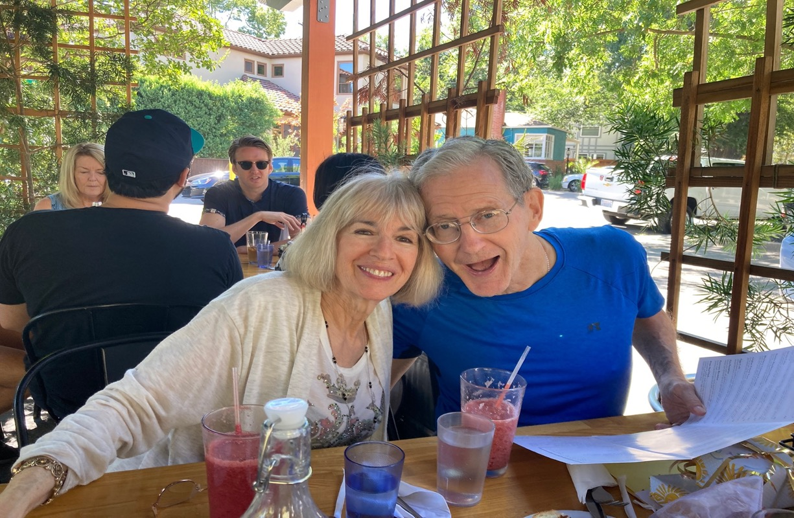

Slide 15
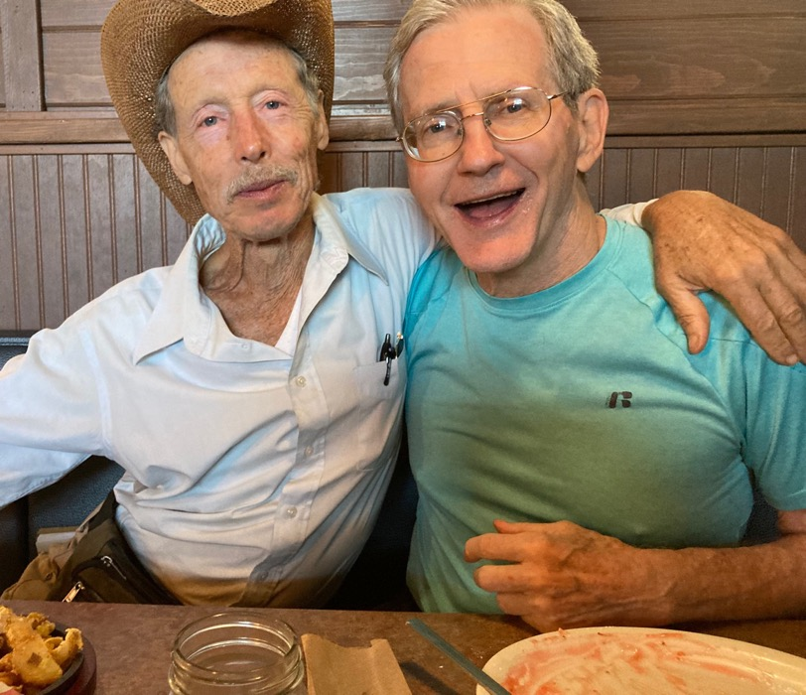

Slide 16
Robert Spread Fun, Music and Inspiration & Had a Huge and Diverse Social Network
His kindness and Leo charisma often made people feel seen and accepted like they were
his “best friend”

Slide 18
Robert’s Family 1948: Mom Phyllis, Dad Charles, Big brother, Chuck and Baby Bobby

Slide 19
Robert’s Devotional Catholic Childhood Heralding A Future Life Direction…
An Acolyte Who Fantasized Becoming A Priest

Slide 20
Robert went to East Providence HS where he received the top athlete scholar award in 1966

Slide 33
Colgate University YearBook JR Year1969

Slide 35
Graduation from Colgate University 1970
Robert lettered in three sports: football, basketball and track. He loved the debate club and writing for the college newspaper.
He majored in business administration and liberal art studies
After graduation he taught at a low- income school serving Black students

Slide 36
Miscellaneous Family Photos
Through the Years
Colgate Graduation and Football Photograph
Times With Aging Parents Charles and Phyllis
Big Brother Chuck Days Before His Passing
“Anorexic-like” Robert After a 40 Day Juice Fast at Ann Wigmore’s Hippocrates Institute where Robert Healed A Chronic Inflammatory Bowel Disease
High School Senior Prom
Wedding Photo with Chuck’s Bride Eileen

Slide 43
Devastating Loss: Sudden Death of Robert’s Beloved Big Brother, Chuck ,After His Jet Crashed One Week After His Wedding to Eileen. Big Catalyst For Bob’s Life Change

Slide 44
“Everything Else Can Wait But
Our Search For God Cannot Wait”
Parmahansa Yogananda

Slide 45
Robert sought Kriya Yoga guidance from two direct disciples of Yogananda: Swami Kriyananda and Roy Eugene Davis

Slide 46
In the late 1970s Robert came to Ananda Village to explore living and working in a spiritual community 300 plus devotees of Paramhansa Yogananda’s Kriya Yoga. It was here in this place and spiritual practice that Robert’s heart found its home and his life’s true purpose

Slide 47
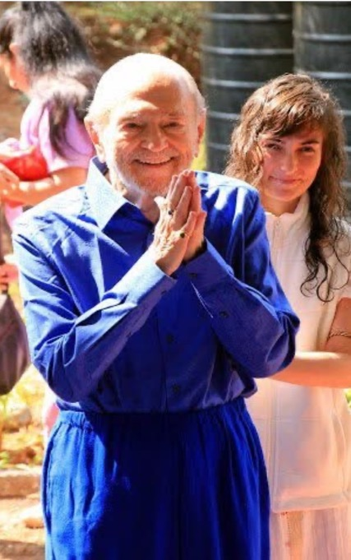

Slide 70
As a popular troubadour and kirtan leader, Robert’s music was featured by renowned musicians and seminar leaders
Deva and Miten in their retreats in Costa Rica and performances in Grass Valley, Center for the Arts
Joyce and Barry Vissel’s conscious relationship and spiritual partnership workshops
Many local kirtans and dance parties along with the Crazy Karma Kirtan Band. They opened for Ram Das’s Nevada City lecture.
Devotional large group chanting Kirtans
Festivals and Dance parties

Slide 72
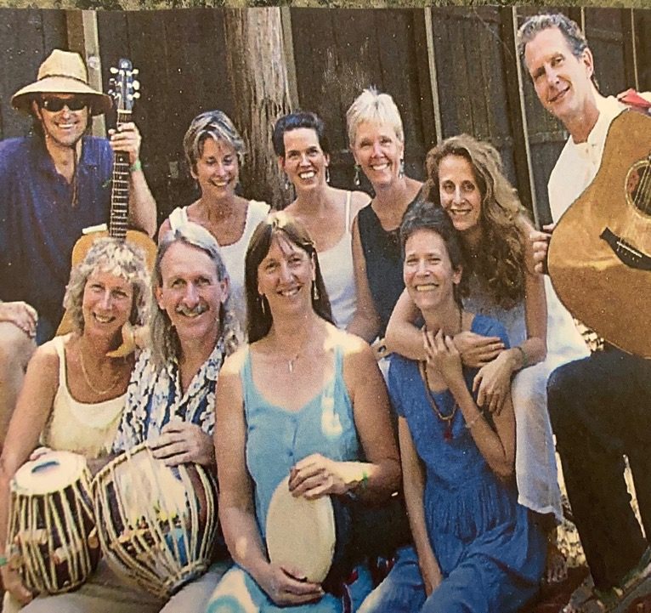
The Crazy Karma Kirtan Band

Slide 73
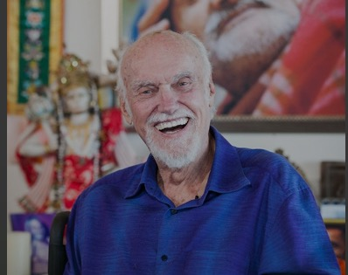
The Crazy Karma Kirtan Band had the privilege of opening for Ram Dass when he gave a talk in Nevada City circa 2008. Despite challenges with expressive aphasia he talked for over two hours and stayed till midnight meeting and hugging audience members

Slide 78
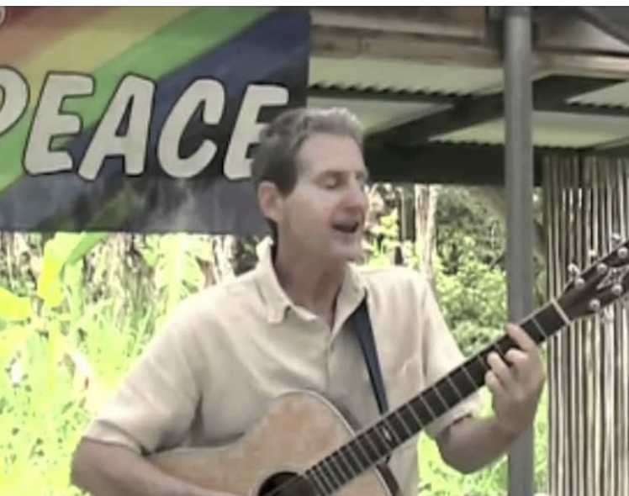
Robert was a super creative and gifted singer-songwriter who produced five CDS and performed in many venues. The Kirtans he led were truly inspirational and healing.

Slide 80
Robert’s Devotional Nature Found a Home in The Divine Feminine: Amma or Amrita Ananda Mayi, A Yogi Saint

Slide 81
Robert wrote a booklet on overcoming sugar addiction called “My Secret Life As A Sugar Addict” and offered workshops locally and in
Hilo, Hawaii

Slide 84
For More Than 40 Years Robert was a beloved yoga and meditation teacher in many locations
Ananda Village Nevada City
Ananda Community Sacramento
Sierra College Grass Valley
Wild Mountain Yoga in Penn Valley
Numerous private students

Slide 88
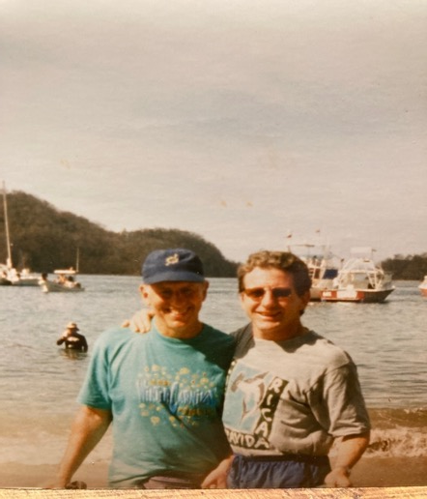
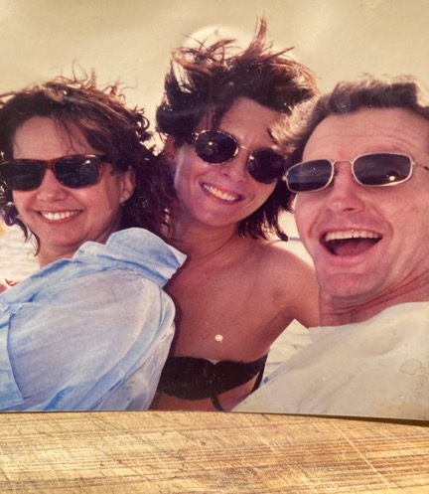
For a time, Robert had an entrepreneurial bent selling multilevel Bluegreen algae, spirulina and chlorella products by CellTech and Purium. Here’s their Costa rica rewards trip

Slide 89
In Bob’s later spiritual questing he travelled to Brazil to experience the faith healer John of God and to Chennai India to participate in a month-long meditation retreat to become a “diksha giver”

Slide 94
For several years Robert was a member of the local Toastmaster’s Club where he gave spiritually uplifting and also humorous talks mirroring his style of songwriting that was more often deeply devotional and occasionally playfully comedic.
Please look at the binders of his songs on the back table
.

Slide 96
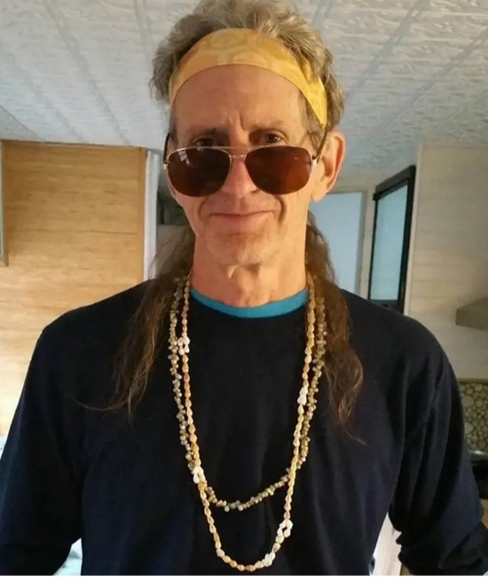
Robert dressed as a “Keith Richard’s twin brother”
This was for a Toastmaster’s speech using humor.
The majority of Robert’s talks were about spirituality and meditation (like his devotional music) and the other talks he loved to show his zany sense of humor

Slide 97
Live Aloha
Two different times Robert lived, worked and worshiped at a Yogananda community on the Big Island of Hawaii called “Polestar” where he helped build accommodations and infrastructure while doing intensive meditation and kirtan practice with his friend Michael Gornick

Slide 98
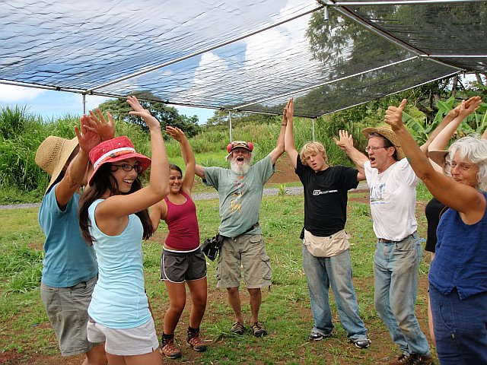
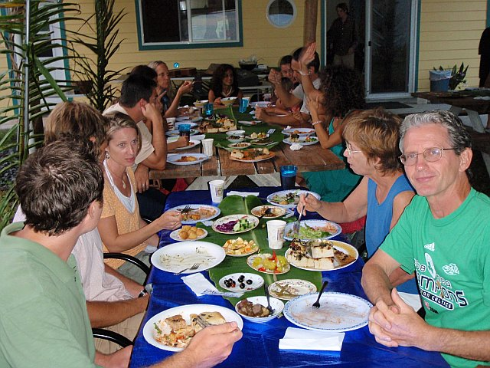
Robert’s First Trip to Work and Meditate at The Newly formed Polestar Community in 2008

Slide 99
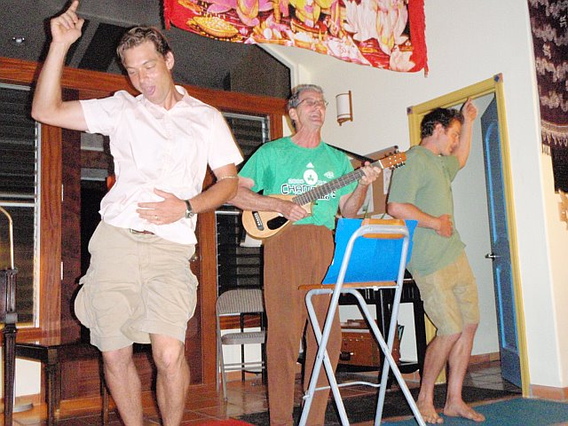
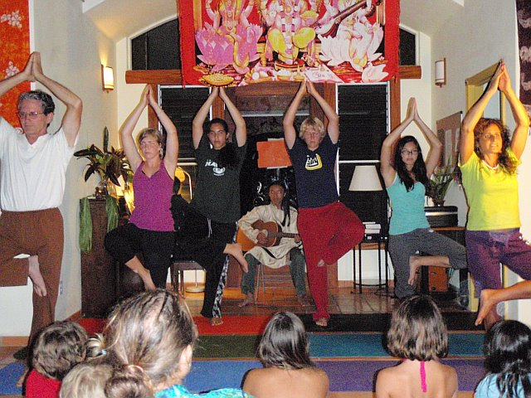
More Scenes From Living in Polestar Community in 2008 Working Meditating Chanting in Paradise

Slide 100
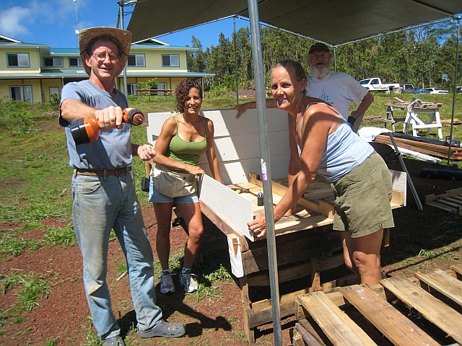
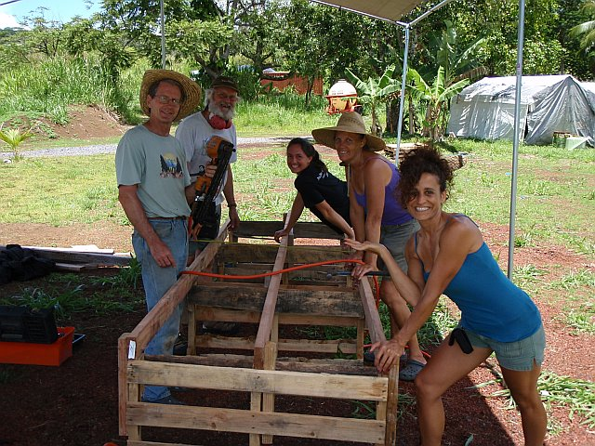
Polestar 2008 Building Dorms, Kitchen, Meditation Center and Gardens

Slide 101
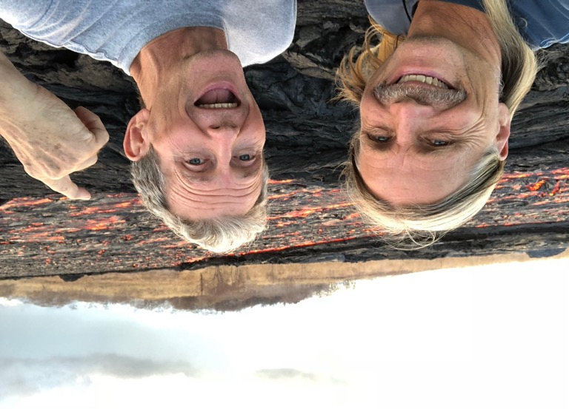
Polestar Lava River Before the Fire and lava destroyed the community in 2018

Slide 102
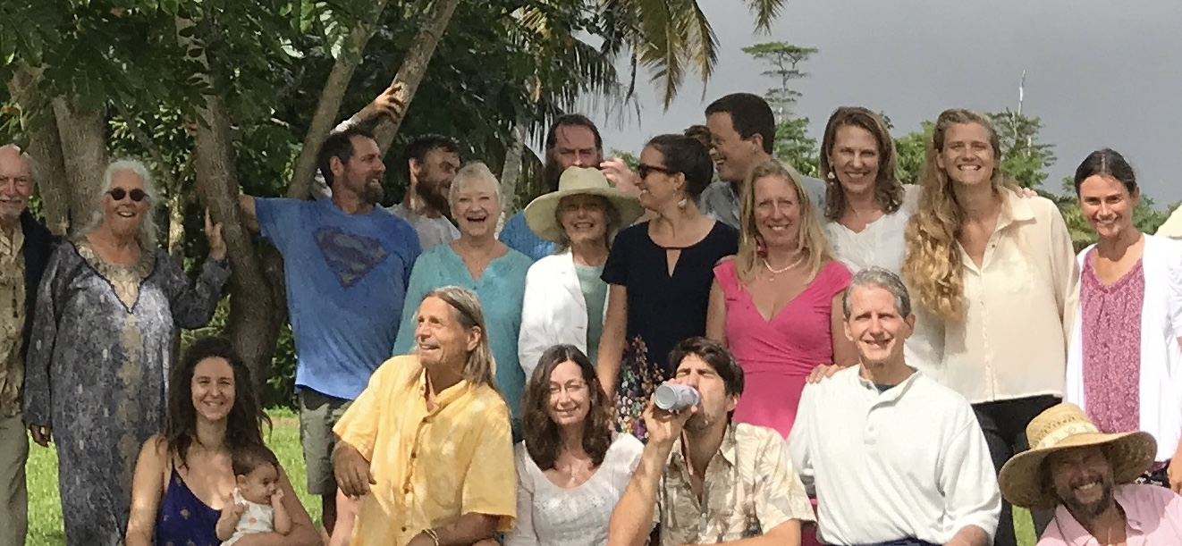

Slide 104
“You Can Just Say Om
And It Will Be Ok”
In a touching Facebook Post After Robert’s Passing one of his Polestar Community roommates recounted a memory that was ”so Robert.” Once when they needed to kill a large nest of poisonous spiders the woman said she felt guilty ending their lives. Robert told her, “just say Om and it’ll be ok.” Upon hearing of his death she wrote, Robert was such a kind and good man I’ll never forget him.”

Slide 106
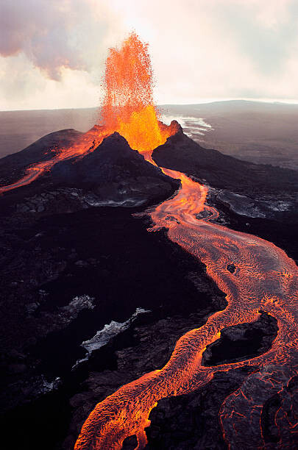

Slide 107
“Good Company Will Make You Good.”
Ongoing spiritual practice support from years of meditation groups at Bruce and Carol Malnor’s house in PennValley. On Easter this group hiked the Buttermilk Trail and made rock pitcairns of their prayers

Slide 110
“Interfaith Kriya Yoga Men’s Group” Ten Years With Robert: deep spiritual explorations and soul support through life’s transitions

Slide 112
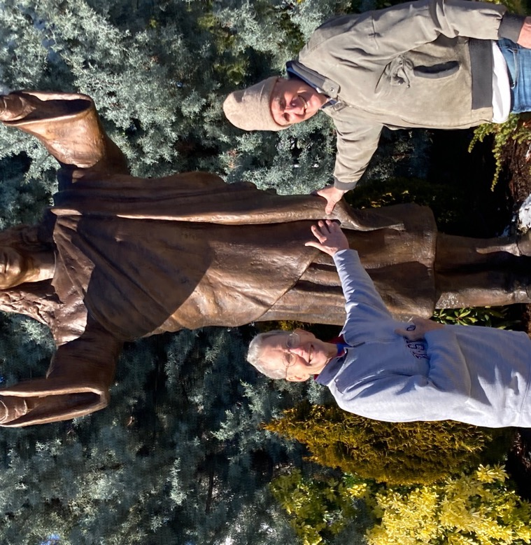
Good Company of Fellow Gurubais on the Path lnspire Each Other

Slide 113
2000-2026: Economic and health challenges led to Robert being ’unhoused” and living at Hospitality House for a year then living at the Bret Harte Senior Home in Grass Valley . The last three years he moved into Assisted Living and Memory Care at Apple Ridge in Sacramento. Initially Robert continued to try to inspire with his community talks on his spiritual journey and sharing his music CDS and playing piano with residents

Slide 116
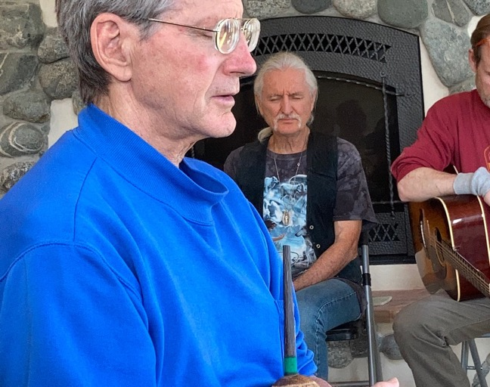
Robert still meditating with advancing dementia at Wild Grace Gathering

Slide 117
During Covid times Robert joined a group of committed meditators that met weekly by Zoom

Slide 119
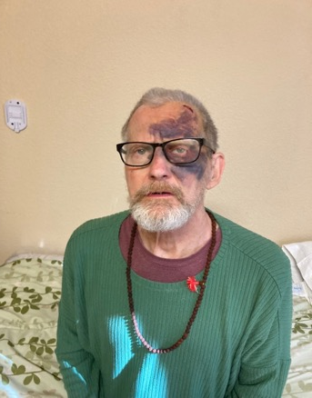
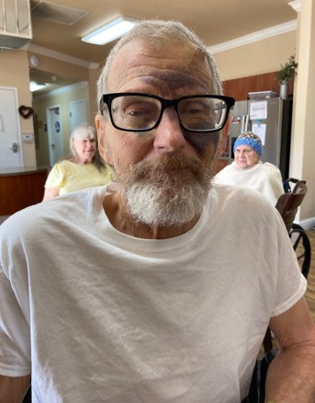
He had many rough transitions to assisted living. Yet, Robert’s resilience transformed adversity by accepting Karmas, surrendering into joy and loving more

Slide 120
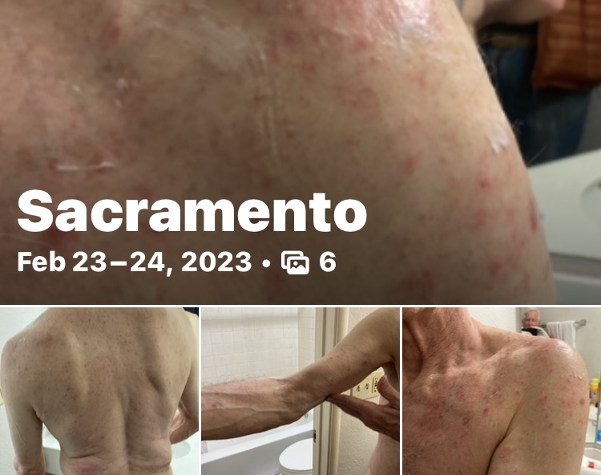
He/We survived a systemic scabies infection
I
Despite being itchy, feverish and miserable in seclusion, he was able to enjoy two movies, some laughs and great Indian Food!
Positive Mental Attitude !

Slide 121
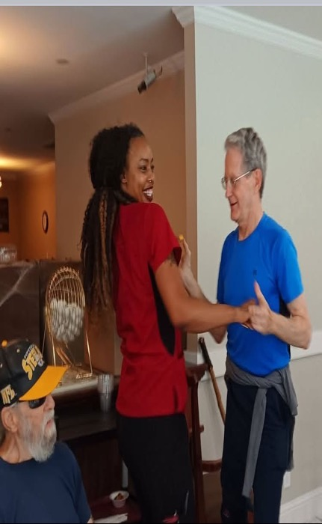
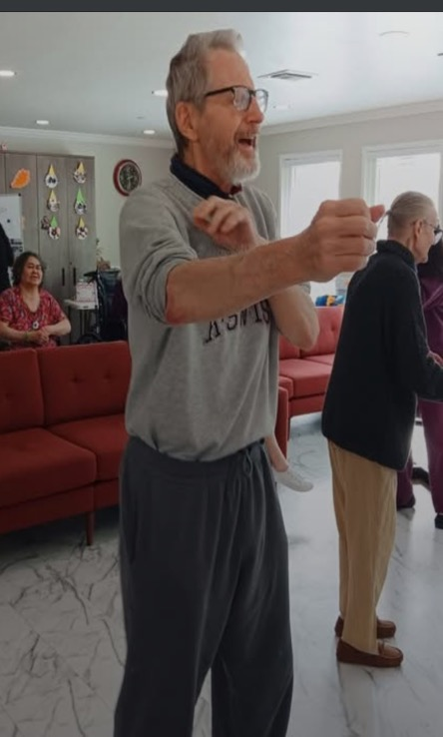
Three Years of Repeated Falls, Multiple ER Visits and Systemic Scabies Infections, getting beaten up etc…
Yet Robert Rose Above it All Each Time! Surrendering, accepting trusting and moving into joy. He had spiritual resilience!!

Slide 122
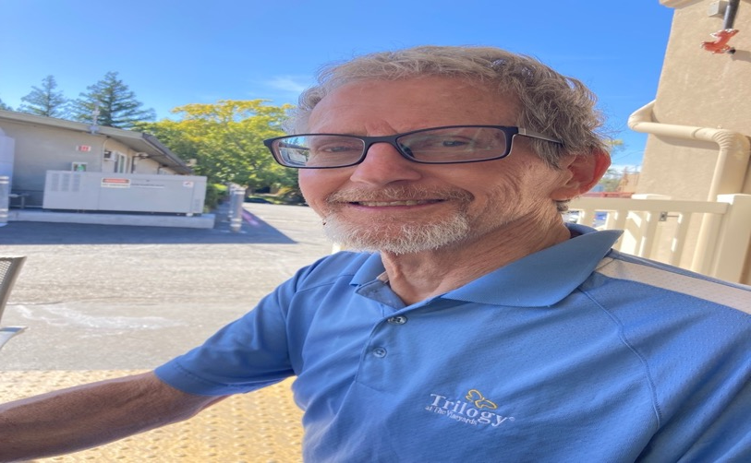
The Director of Apple Ridge Assisted Living called Robert “The Love Bunny” as his beautiful heart elevated the attitude of patients and staff

Slide 123
Life-long Friends Visited & Brought Robert Joy

Slide 124
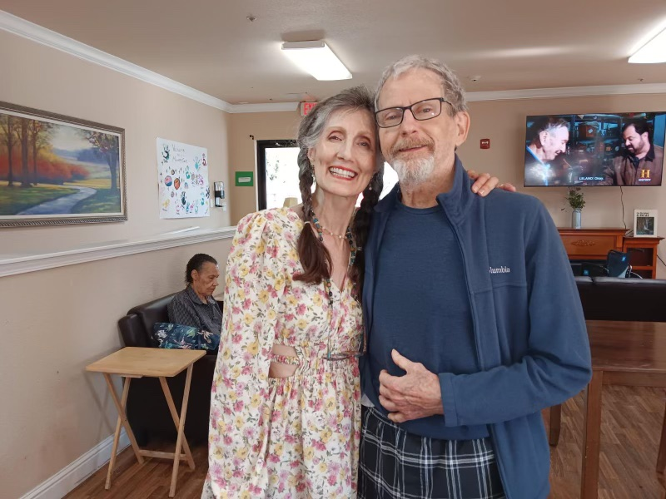

Slide 125
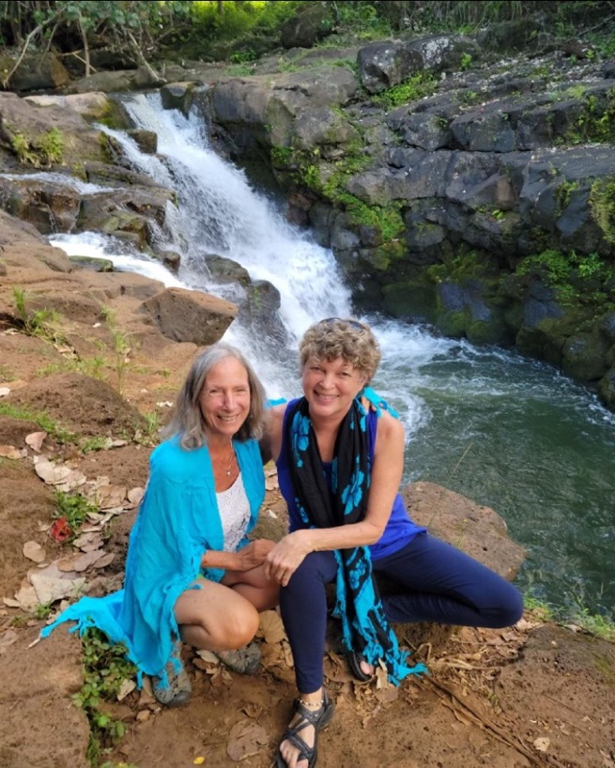

Slide 126
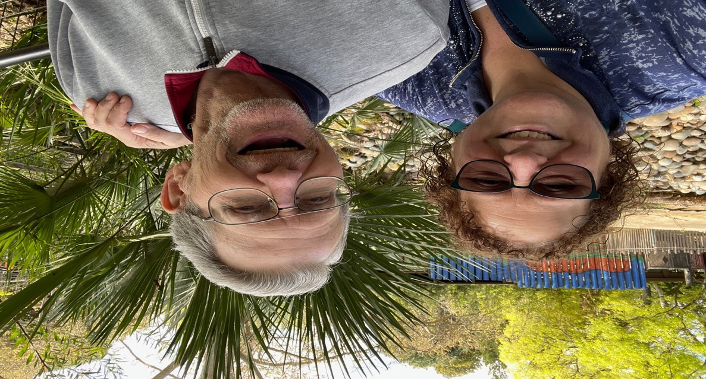

Slide 127
Christmas three weeks prior to his mahasamadhi
He was delighted to receive a Yogananda 2026 calender, a Hanuman statue (as he was a lifelong servant to many) and a bracelet reminding him of his favorite song, “Love Serve and Remember” Why have you come to Earth? Why have you taken birth: Love, Serve and Remember (God)

Slide 128
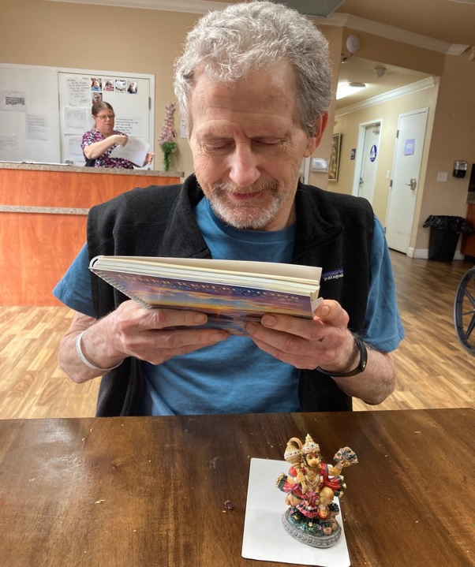

Slide 129
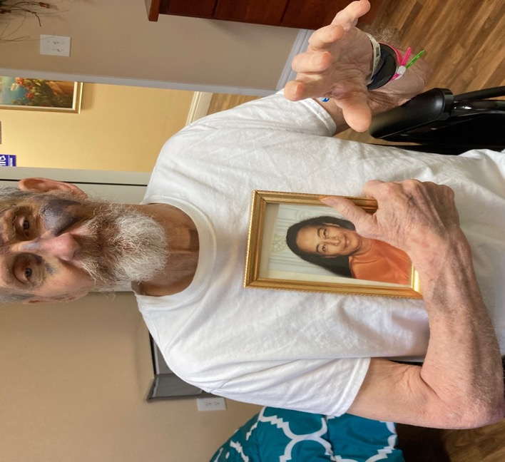
Talks with Robert about soon leaving his body, mahasamadhi

Slide 131
Robert’s spirit finally let go hearing the last words “Go to your Guru” spoken by Mary Schooley and he was gone shortly after.

Slide 132
After Robert’s Passing several staff members told me that Robert’s unique ways of expressing kindness to others and the acceptance of his challenging cognitive and mobility issues really inspired them. “He was a truly unique and positive human being, that had a powerful impact on my life.”
Robert was a teacher, a friend and a healer until the end

